Slide 1
NLPs: Movie Reviews & Stock Prices
By: Tyler Gehbauer, Gurpratap Singh, Nelson Lubinda, Nitish Arora, Demi

Slide 2
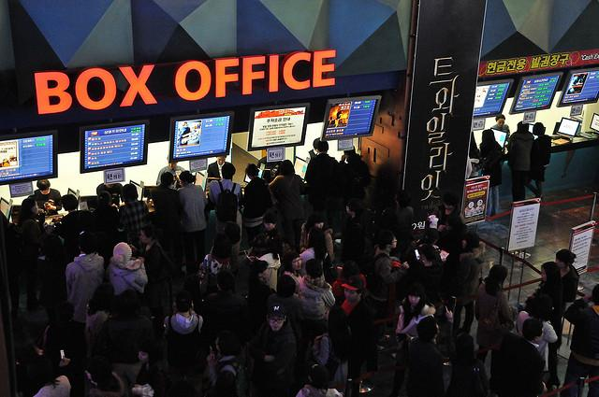
Introduction
All of us in this group love movies
Instead of analyzing movies, we wanted to analyze the statistics and data behind it.
Specifically, how critic consensus effects movie performance and how that can tie into stock price.

Slide 3
Project Summary and Goals
For our project, we decided to look at box office data and critic consensus for 3 major motion picture companies: Netflix, Disney, Universal (Comcast)
With all this data, we then used NLP (Natural Language Processing) and machine learning to predict future trends in stock prices for each of these companies
We believe by doing so, we can establish a framework for future financial tech enthusiasts who are interested in building their own fintech model.

Slide 4
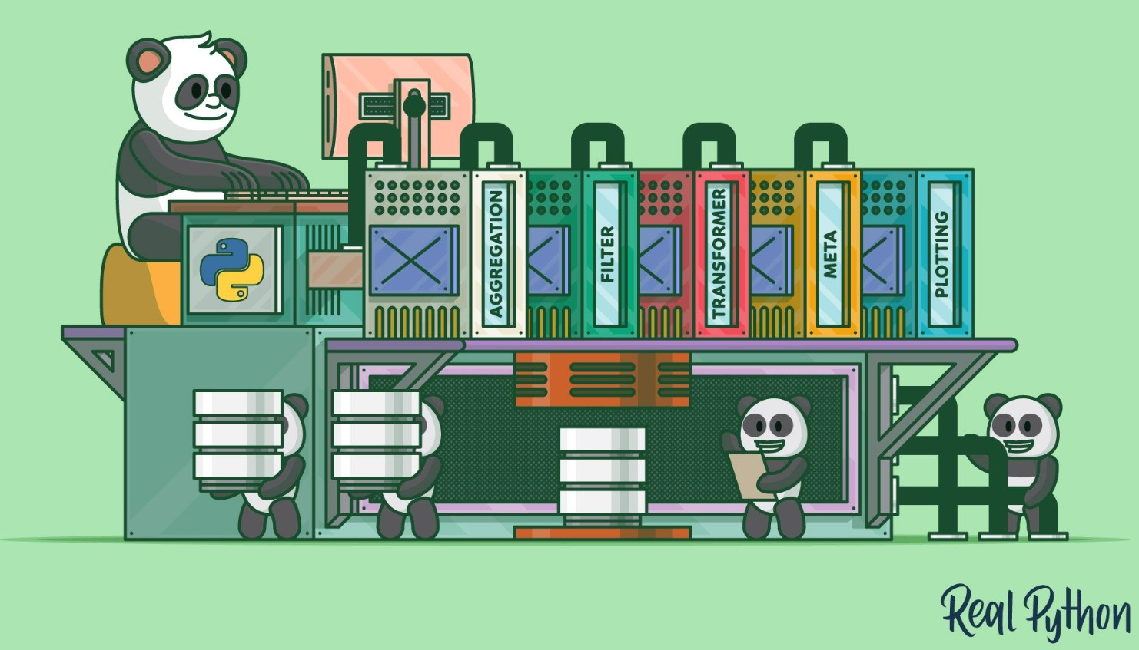
Techniques and Libraries
We decided to use multiple libraries that have not been covered in our course yet:
Granger Causality Test
Flair
VADER
CIRCLIFY
Text2Blob (specifically to return polarity and subjectivity)

Slide 5
Demonstration

Slide 6
Results

Slide 7
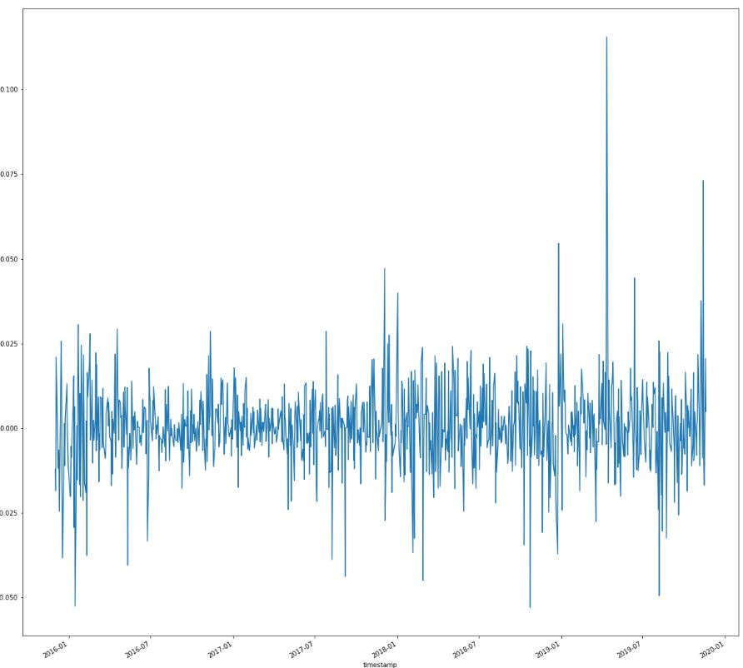
Daily Return (Disney)
Notes:
Daily Return

Slide 8
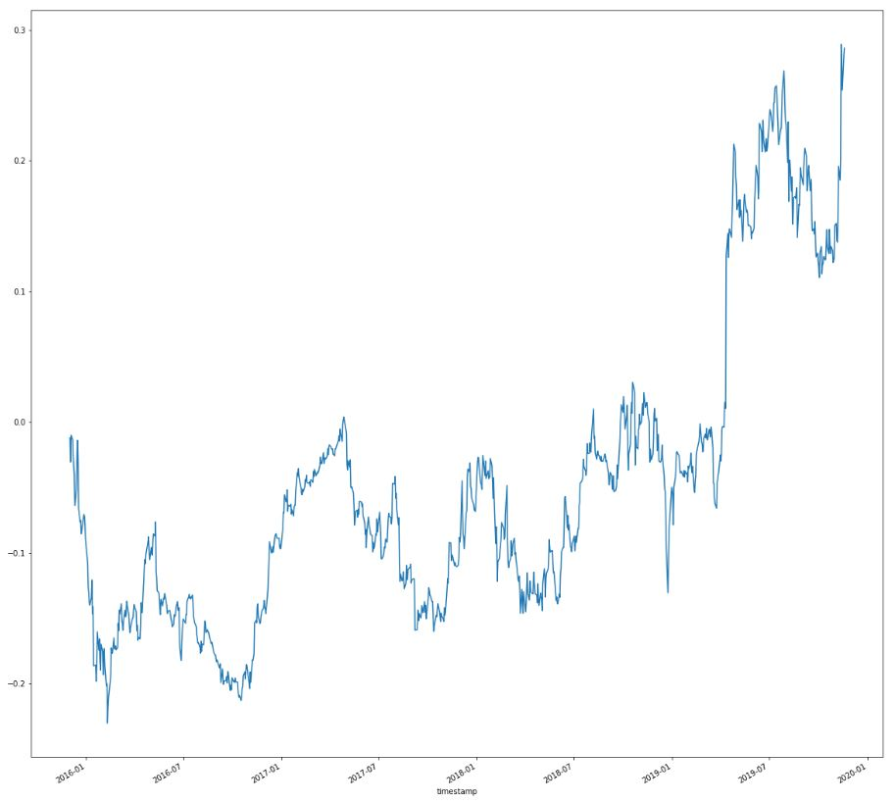
Cumulative Return (Disney)
Notes:
Cum. Return

Slide 9
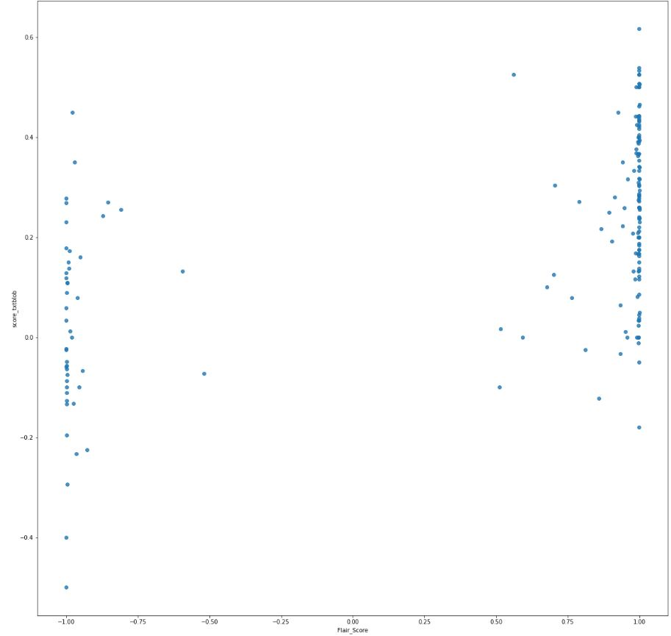
Flair v TextBlob (Disney)
Notes:
Textblob V FLAIR

Slide 10
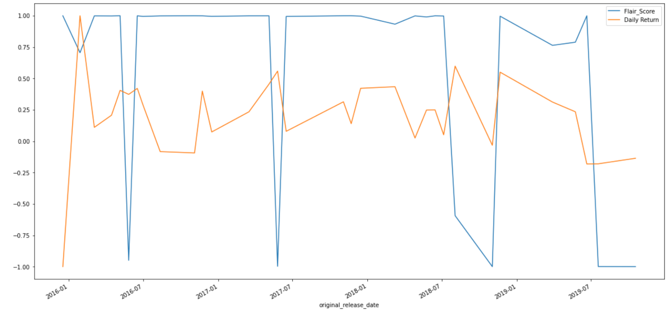
Flair v Daily Return (Disney)
Notes:
FLAIR V DR

Slide 11
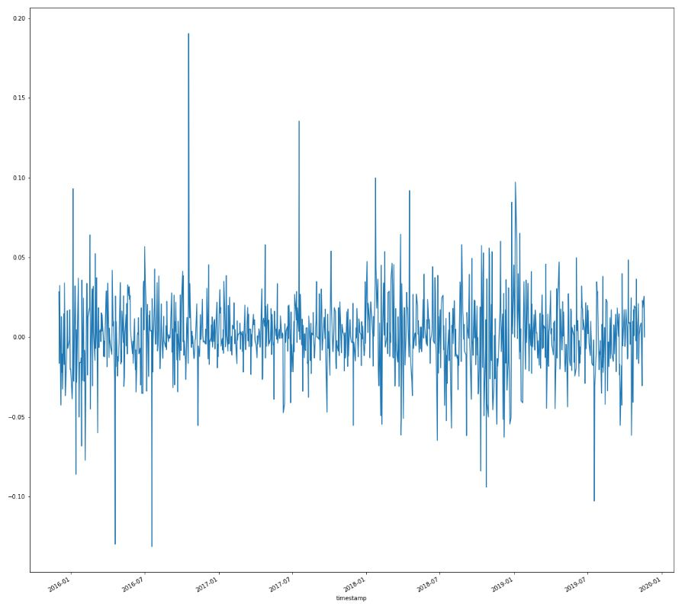
Daily Return (Netflix)
Notes:
Daily Return

Slide 12
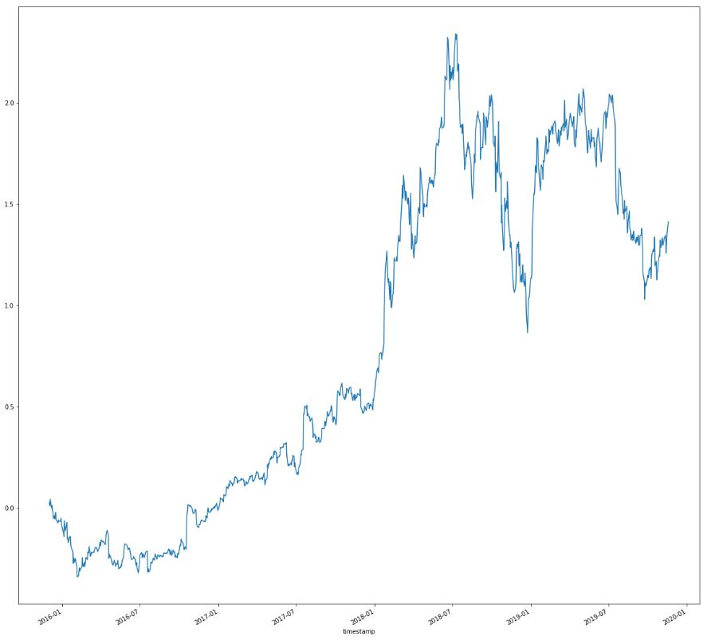
Cumulative Return (Netflix)
Notes:
Cum. Daily Return

Slide 13
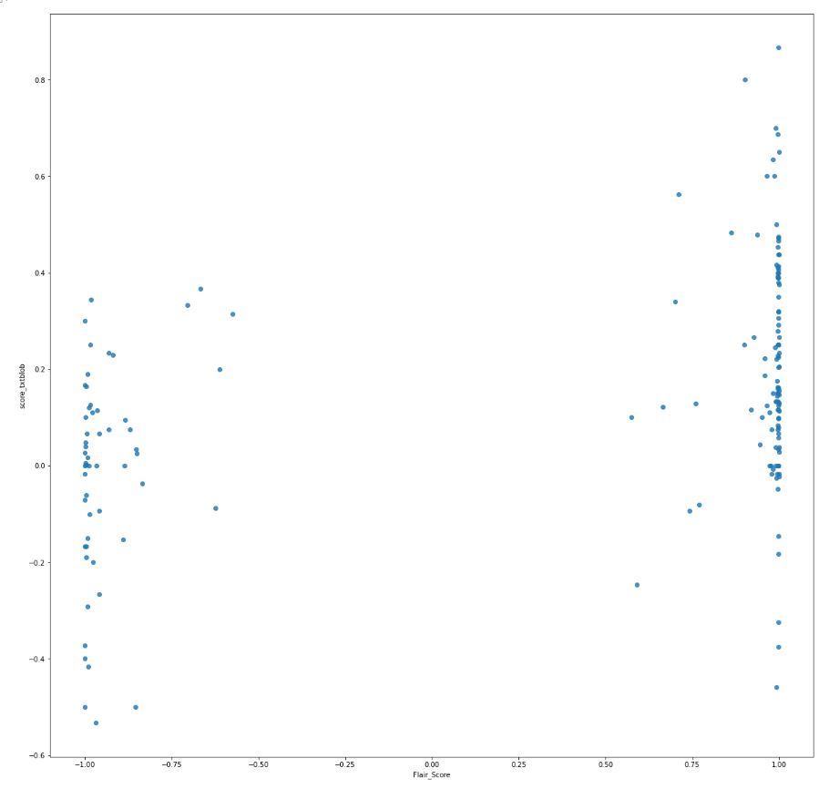
Flair v TextBlob (Netflix)
Notes:
FLAIR V TEXTBLOB

Slide 14
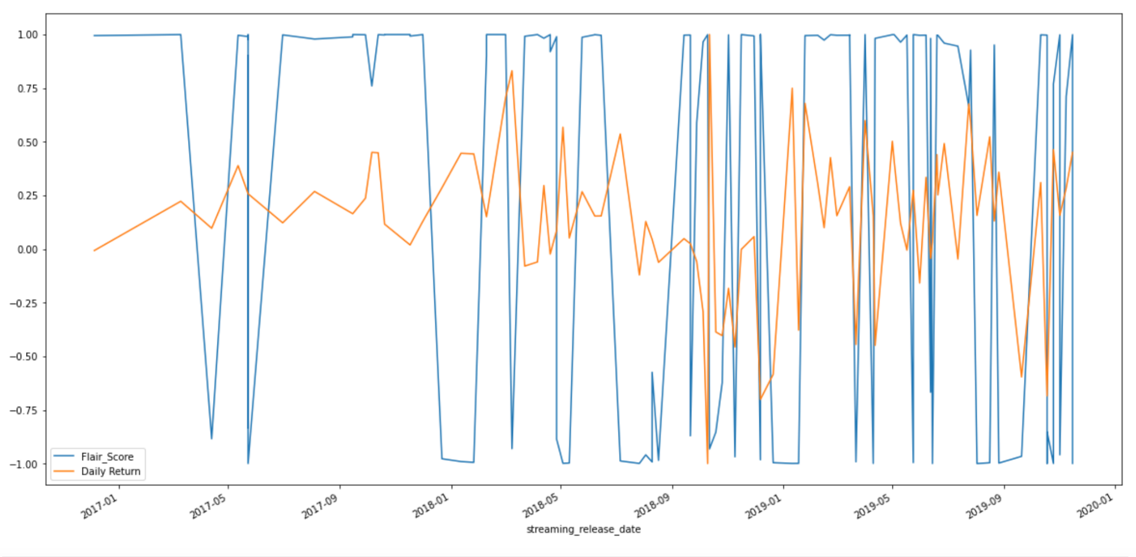
Flair V Daily Return (Netflix)
Notes:
FLAIR V DAILY RETURN

Slide 15
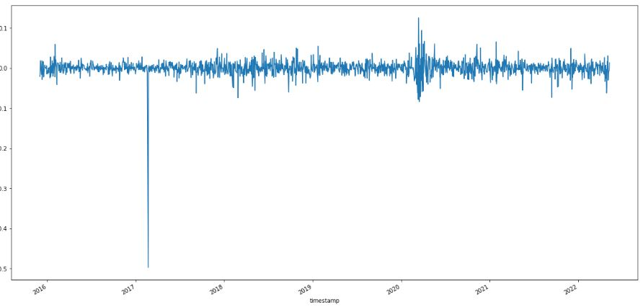
Daily Return (Universal)

Slide 16
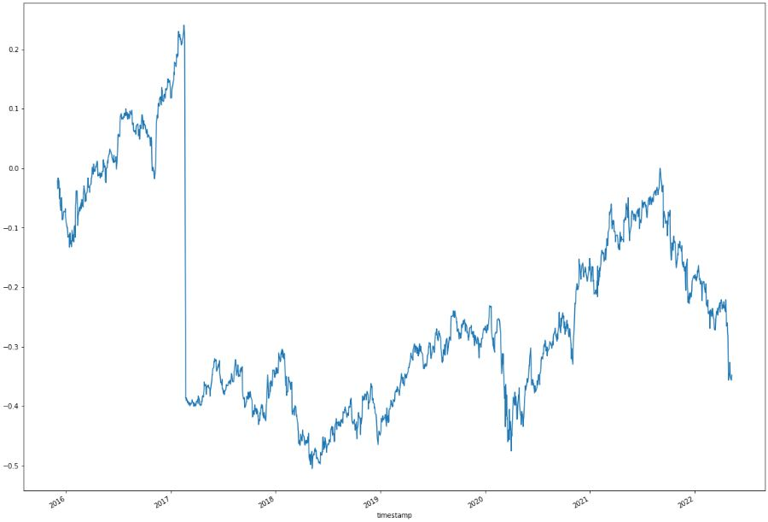
Cumulative Return (Universal)

Slide 17
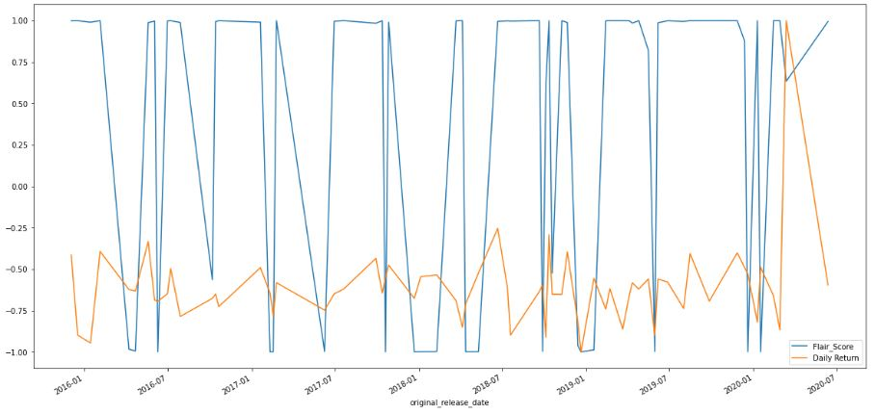
Flair v Daily Return (Universal)

Slide 18
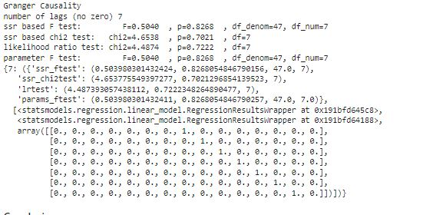
Analysis
By Using the Granger Causality method, we determined a 2D array with 2 columns as the main argument.
We were able to get a P-Value and depending if it was above or below a certain threshold, we can prove if our hypothesis of critic consensus impacting stock price value is correct
Therefore, the P value was above .05, which overall states critic consensus does NOT affect stock price
Example: Universal

Slide 19
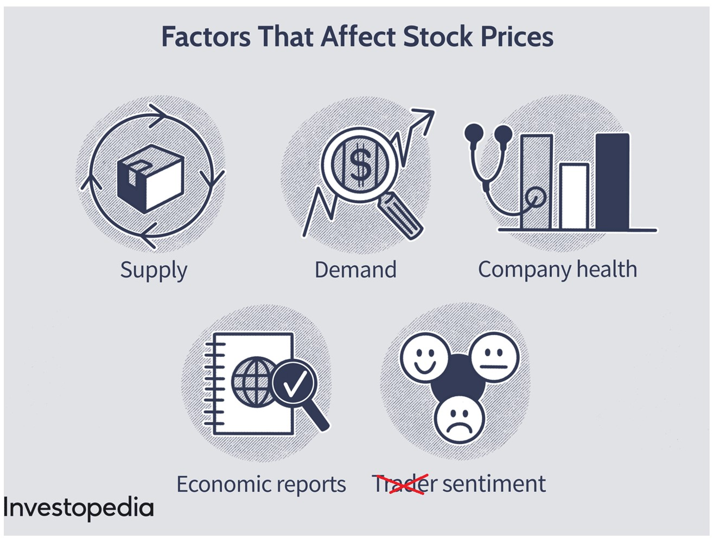
Conclusion and Next Steps
As stated before, critic consensus overall does not impact stock price as much as we thought it would for each of the 3 major companies
After compiling all this data, we would have liked to also see how audience consensus also affects stock price value as well.
We also wanted to look at more companies and use sentiment as one of the features along with Genre, Director, Synopsis and tickets sold to find the correlation using neural networks and PCA.

Slide 20
References
www.alpaca.com
https://www.analyticsvidhya.com/blog/2021/08/granger-causality-in-time-series-explained-using-chicken-and-egg-problem/
https://www.sciencedirect.com/science/article/pii/S2666285X2100008X
https://www.kaggle.com/datasets/stefanoleone992/rotten-tomatoes-movies-and-critic-reviews-dataset?select=rotten_tomatoes_movies.csv
https://www.researchgate.net/publication/282049046_The_Effects_of_Twitter_Sentiment_on_Stock_Price_Returns
https://www.analyticsvidhya.com/blog/2021/08/granger-causality-in-time-series-explained-using-chicken-and-egg-problem/

